Slide 1

"HITNESS":
WHAT DEFINES A HIT SONG?
By: Jae, Wendy, Sudhish, Hagen
Notes:
Jae
Good morning/afternoon everyone.
We are group 1 and my name is Jae
For our final project, we are exploring the concept of "Hitness" i.e. what defines a hit song?
Image source:
https://unsplash.com/s/photos/music-wallpaper

Slide 2

ABSTRACT
Why do some songs do well and other's don't?
Notes:
Hagen
We wanted to answer this question to help music producers, in an ever-expanding music industry, evaluate their music prior to release to minimize loss and maximize success.
We will do this by analyzing Spotify audio features, the sentiment of lyrics, and artist popularity.
Image source:
https://www.pexels.com/search/music%20background/

Slide 3
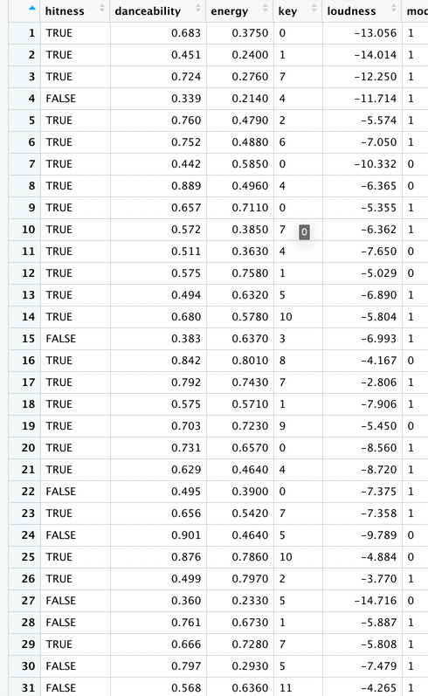
DATA COLLECTION
BILLBOARD HOT 100
SPOTIFY
MUSICOSET
GENIUS
Notes:
Hagen
To construct our model, we used 4 primary sources of data.
These were the Billboard Hot 100 dataset, Musicoset dataset, the Spotify API, and the Genius API.

Slide 4

BILLBOARD HOT 100
Sourced from Dhruvil Dave on Kaggle
From 1958 to 2021
Notes:
Wendy
The first dataset we gathered was the Billboard Top 100. We gathered this from Kaggle, and the set contains every song on the chart from 1958 to 2021.
The reason why we chose the billboard 100 to measure hitness of a song is because chart rankings in billboard are based on sales, both physical and digital, radio, and online streaming in the United States. On the other hand, if we were to choose an online streaming platform like Spotify, we would only have the streaming data from the platform itself.
image source:
https://www.billboard.com/pro/billboard-hot-100-number-one-calculations-6ix9ine/

Slide 5

SPOTIFY AUDIO FEATURES
acousticness
danceability
energy
key
liveness
loudness
mode
speechiness
tempo
time_signature
valence
Notes:
Jae
Then with the songs from Billboard Hot 100, we utilized the Spotify API to find the audio features of each song.
Spotify provides 11 different audio features for each song which are listed here.
For our project, we collected these features for every charting song between 2008 and 2018.
Image source:
https://newsroom.spotify.com/media-kit/logo-and-brand-assets/

Slide 6
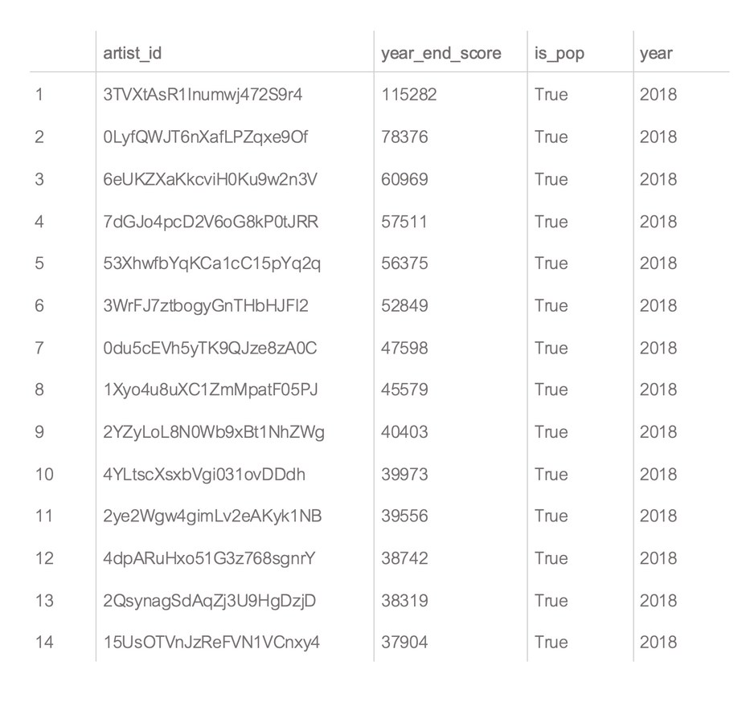

MUSICOSET
Sourced from Mariana O. Silva, La´ıs M. Rocha, Mirella M. Moro
From 1964 to 2018
Notes:
Wendy
The next database that we use is from musicoset. This is a dataset of musical elements. It contains data about songs, albums, and artists.
The table we use contains information about artists, like artist id, score of popularity, and year.
image source:
https://marianaossilva.github.io/DSW2019/

Slide 7



ARTIST POPULARITY (COLLABORATIONS AND FEATURES)
Notes:
Jae
With this population data we needed to calculate a popularity score for each song.
To do this we took the max artist popularity during the duration in which a song was charting.
This metric also allows us to take into consideration possible collaborations and features. As we can take the max popularity of all the artists involved in a song.
Image source:
- https://pitchfork.com/reviews/albums/giveon-give-or-take/
-https://en.wikipedia.org/wiki/Love_Poem_%28EP%29
-https://pitchfork.com/reviews/albums/jack-harlow-come-home-the-kids-miss-you/

Slide 8

GENIUS
LYRIC GATHERING
The Genius API in combination with the Python library lyricsgenius which directly utilizes HTML parser BeautifulSoup
Notes:
Sudhish
Finally, we utilized the Genius API to extract lyrics for each song by searching for the artist and the song.
We used lyricsgenius python package to parse through the HTML of the Genius website for song lyrics.
The lyrics for songs that could not be found through searching the genius website were manually added to our data frame by importing a CSV with the song name and the lyrics.

Slide 9
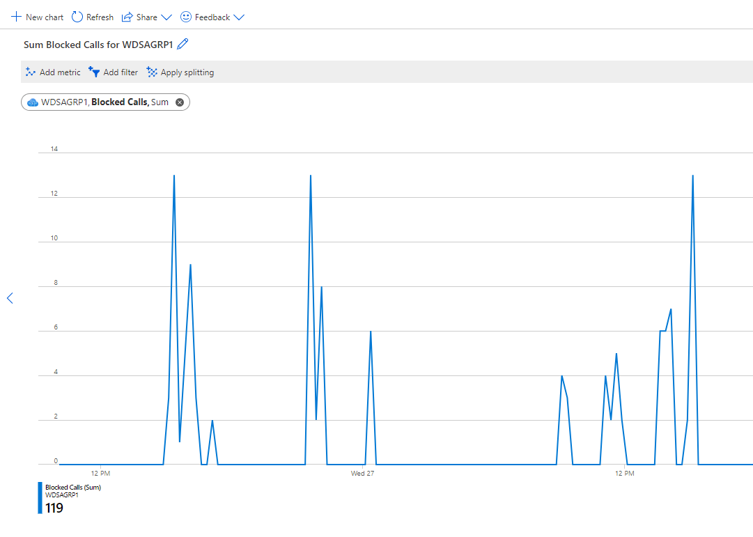
SENTIMENT ANALYSIS TRIALS
TextBlob
Microsoft Azure
Unreliable Results
Blocked calls
Notes:
Sudhish
Our first iteration of sentiment analysis was using Microsoft Azure's sentiment analysis through the language module. Even though it was promising at first, as you can see here we were constantly rate limited and our calls were blocked by the API.
Our next try was using TextBlob, which, like Azure, is a Natural Language Processing module. However we were faced with the issue of unreliable results as TextBlob returned a flat polarity of 0 for many lyrics

Slide 10

VADER
Lexicon and rule-based sentiment analysis tool
Notes:
Sudhish
To overcome this we used Vader.
Vader is a Lexicon and Rule-based sentiment analysis tool which we use due to its speed and reliability.
Unlike TextBlob and Microsoft Azure, which are Natural Language Processing analyzers, Vader searches through a statement to see how many words are contained inside of its lexicon of 7,500 words.
We use Vader to analyze the lyrics of every song in our dataset and added the polarity to our dataframe.
Q and A
The sentiment value of these are collected from Amazon Mturk. Vader then uses that information to calculate how positive or negative the statement is.

Slide 11

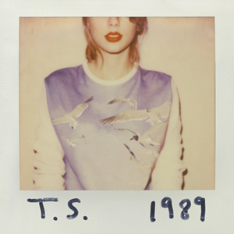
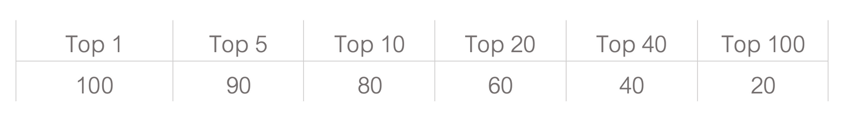
'Hitness' of a song is scores by sum of charting position for every week on Billboard Hot 100
HITNESS
Notes:
Wendy
Hitness is the word we uses to measure how hit a song is.
Hitness is score by adding points associated with charting position for every week the song stays in billboard top 100.
Song that charted top 1 is given 100 points, 90 points for top 5, 80 for top 10, 60 for top 20, 40 for top 40, and lastly, 20 for top 100.
This is in order to account for how high a song charts and how long a song stay in the chart.

Slide 12
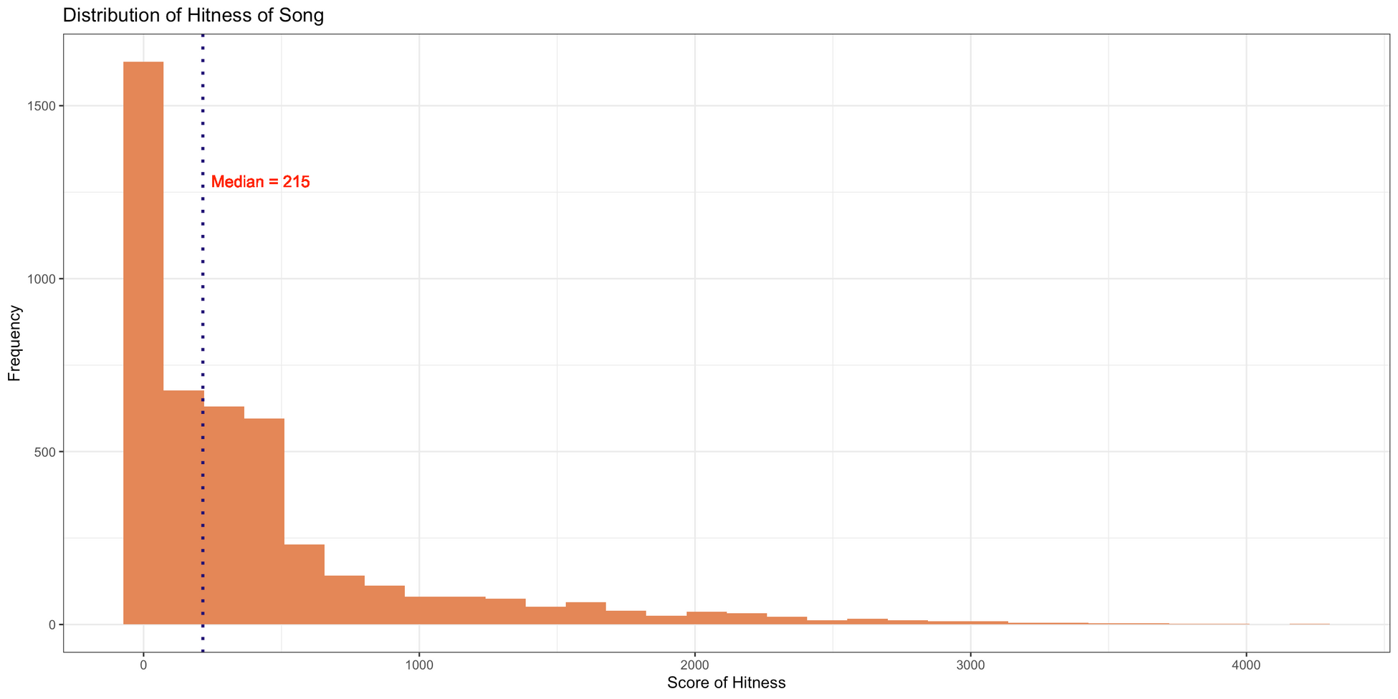
EXPLORATORY DATA ANALYSIS
Notes:
Hagen
When doing the exploratory data analysis one objective was to find the cutoff or threshold for what we considered a hit song.
Plotting the distribution of hitness as a histogram let us
see that the distribution was strongly right-skewed.
Accordingly, we chose our threshold to be a value close to the median but slightly higher as we believed it should be slightly harder for a song to be considered a hit song. In the end our threshold was 250

Slide 13
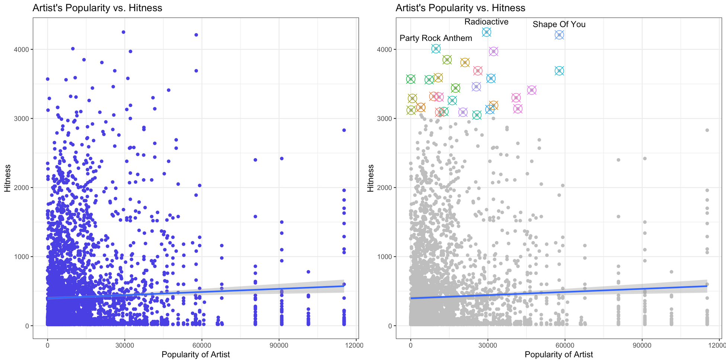
EXPLORATORY DATA ANALYSIS
Notes:
Wendy
Next, we also graph artist's popularity versus hitness of a song to see how this factor would influence hitness.
We then run a linear regression for data and it exhibit a positive correlation. However, as you can see, there is a lot of variability.
Because the objective of our study focused on analyzing hit song, we zoom into the top 30 song with highest hitness score to examine the relationship. From this, we can see a clearer positive correlation.

Slide 14
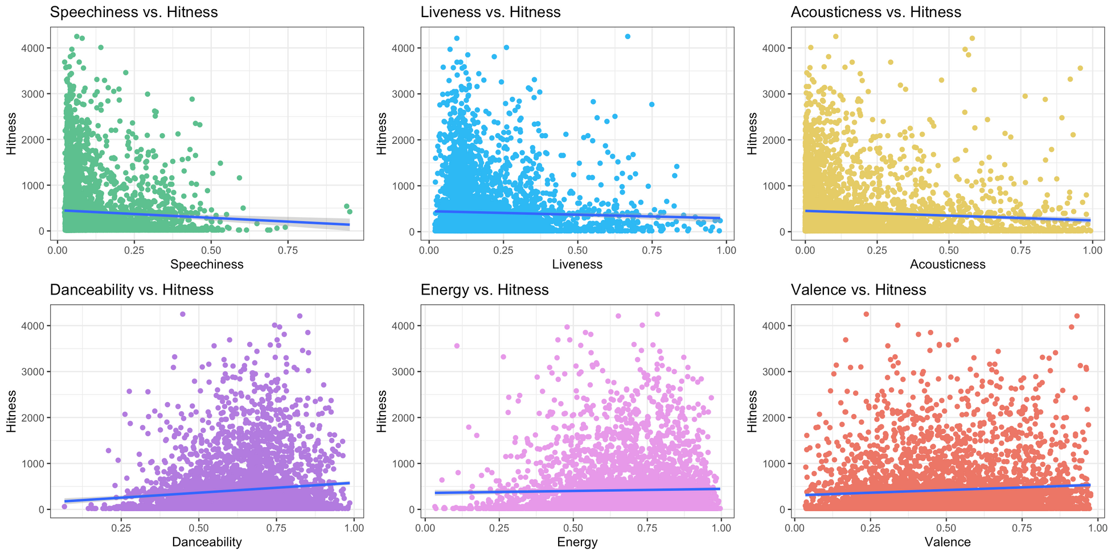
EXPLORATORY DATA ANALYSIS
Notes:
Wendy
Next, we decided to graph hitness vs. our continuous variables.
Overall, every characteristics of the songs seems to be influencing the hitness of a song differently.
For some, like speechiness, liveness, and acousticness, as x increases, hitness level would decreases.
While for others, like danceability, energy, and valence, hitness level increases when x increases.
However, our models have big variability. Although if we examine if carefully, for speechiness and danceability, we can see that the slope appears to be steeper and more intense in contrast to other graphs.
However, we need further analysis to see which factor is significant.

Slide 15

DATA PREPARATION
Notes:
Jae
In order to do this, we first prepared our data for different models. We first tried different methods of scaling. We had our base data with no scaling. For the duration, we changed the unit of time from milliseconds to minutes. Finally, for tempo and popularity, both values were much higher compared to the other variables. Therefore, we tried two different methods to scale them. First, we tried scaling by dividing the maximum value of each variable. Second, we tried log scaling the values.
Then we split our data into training and testing. We used 75% of our data for training and 25% for testing.
When we do this our base line is prediction accuracy is around 53%.

Slide 16
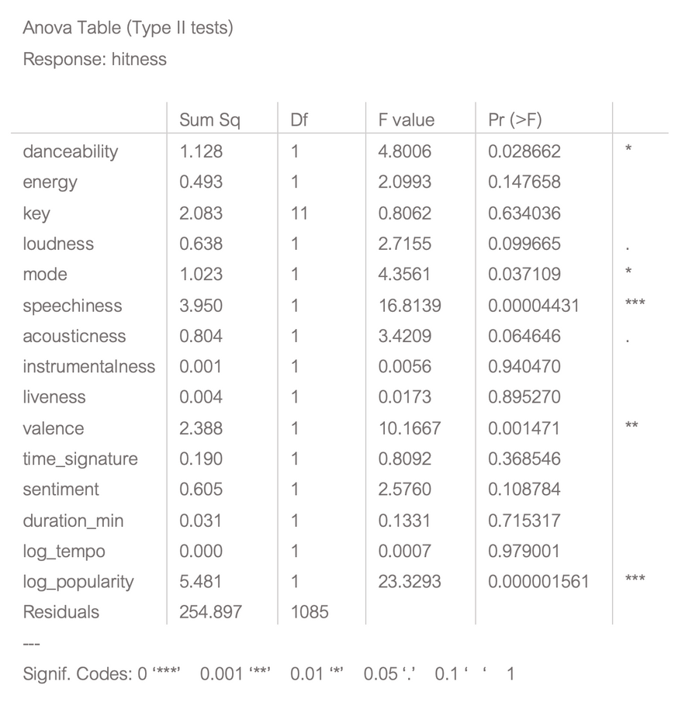
LINEAR MODEL (OLS)
Log Scaled
Testing Accuracy (%)
Base: 59.8
Max Div: 60.2
Log: 62.1
Notes:
Sudhish
We first trained a linear model in R using all the variables.
The linear model with no scaling achieved a testing accuracy of 59.8 percent, maximum division scaling had a testing accuracy of 60.2 percent, and the log scaling had a testing accuracy of 62.1 percent.
The log scaling seems to offer the best results. Looking at the Anova table we can see that speechiness and popularity have the strongest correlation followed by valance and danceability.

Slide 17
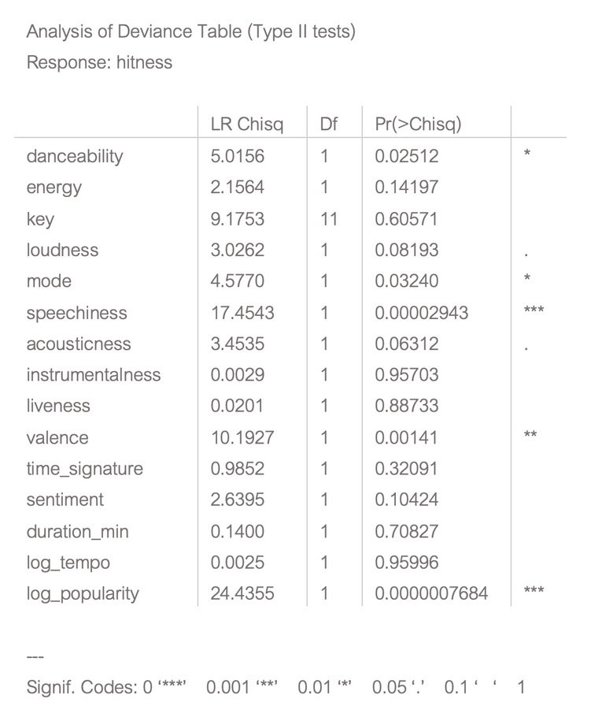
LOGISTIC REGRESSION (GLM)
Log Scaled
Testing Accuracy (%)
Base: 59.9
Max Div: 60.3
Log: 62.0
Notes:
We then followed with logistic regression with GLM.
Similar to the linear model, the logistic regression model with no scaling achieved a testing accuracy of 59.9 percent, maximum division scaling had a testing accuracy of 60.3 percent, and the log scaling had a testing accuracy of 62 percent.
The P-values and relationship between variables also seem proportionally similar

Slide 18
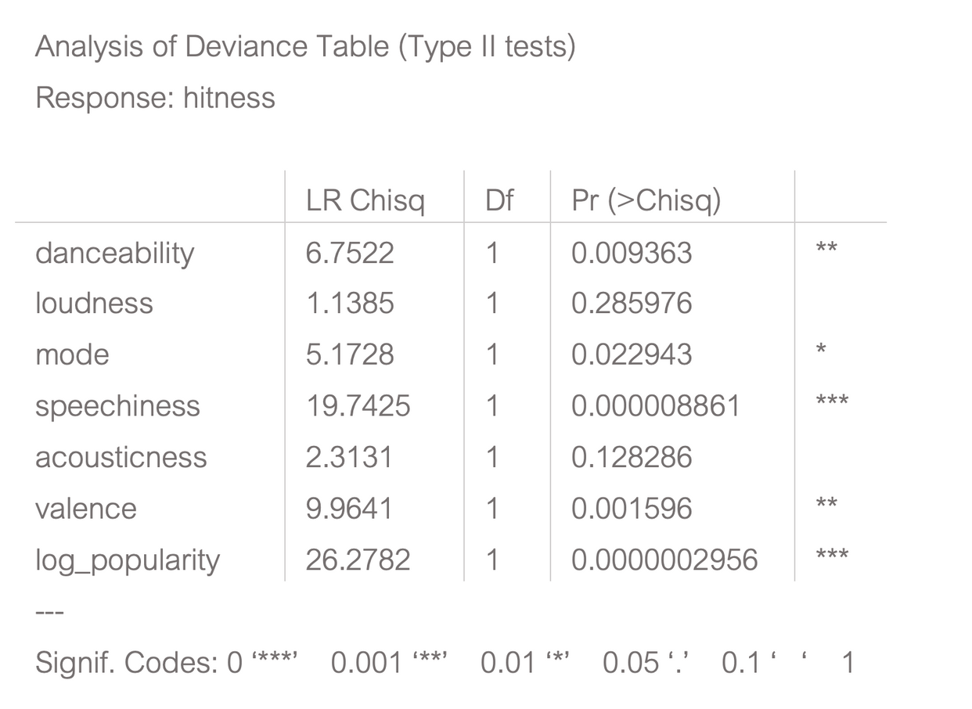
LOGISTIC LASSO REGRESSION (GLM)
Log Scaled
Testing Accuracy (%)
Base: 54.9
Max Div: 56.3
Log: 61.4
Notes:
Continuing, we tried logistic lasso regression.
Our results were slightly worse than the linear and logistic regression model for the non-scaled and max-division scaled at 54.9% and 56.3% accuracy respectively.
Our results for the log scaled model were similar to both models, however, at 61.4% accuracy.
In addition, the correlation between variables and hitness seems to similar as well.

Slide 19
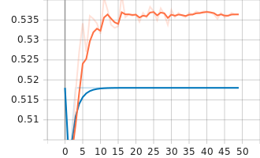
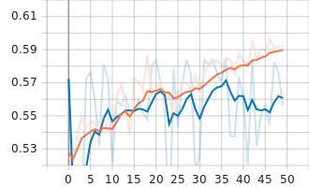
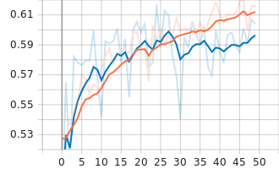
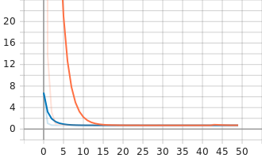
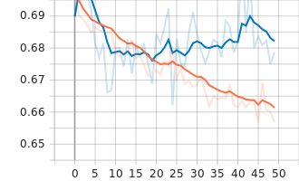
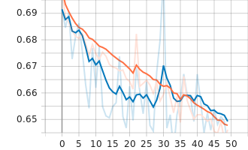
DEEP NEURAL NETWORK
Base (No Scaling)
Testing Accuracy: ~54%
Max Divide Scaling
Testing Accuracy: ~57%
Log Scaling
Testing Accuracy: ~61%
Notes:
Jae
Moving to Python we tried training a deep neural network. Our network had 5 hidden layers with 4 dropout layers in between. Each hidden layer had a ReLU activation function and 1000 neurons.
Our output layer used the sigmoid activation with two neurons: one for hit and one for non-hit.
The model used the Tensorflow Binary Crossentropy loss function and the Adam optimizer function and was trained on 50 epochs.
The model reached a testing accuracy of around 60-62 percent with the log scaled data. The unscaled and max divison scaled data did considerably worse at around 54% and 57% respectively.

Slide 20
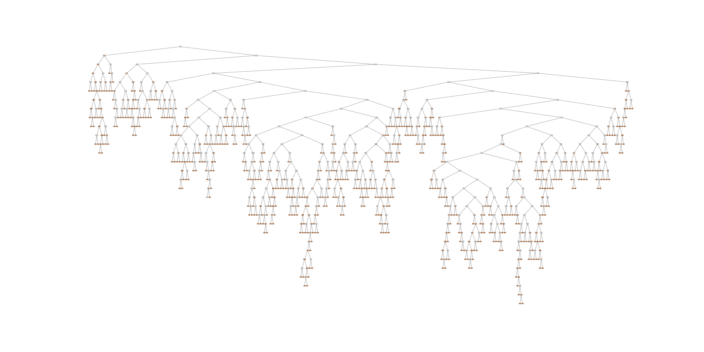
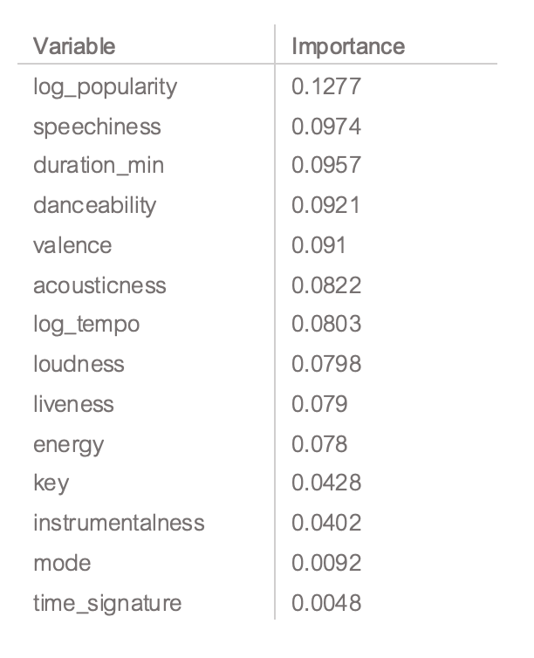
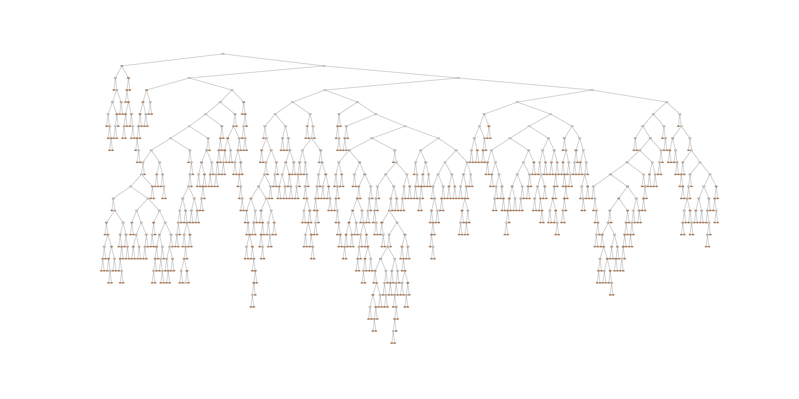
RANDOM FOREST
Testing Accuracy : ~60% with all
Notes:
Finally, we tried a random forest. We achieved a testing accuracy of 60% regardless of scaling.
The feature importance ranking also showed similarity to the linear and logistic regression models we tried before.

Slide 21
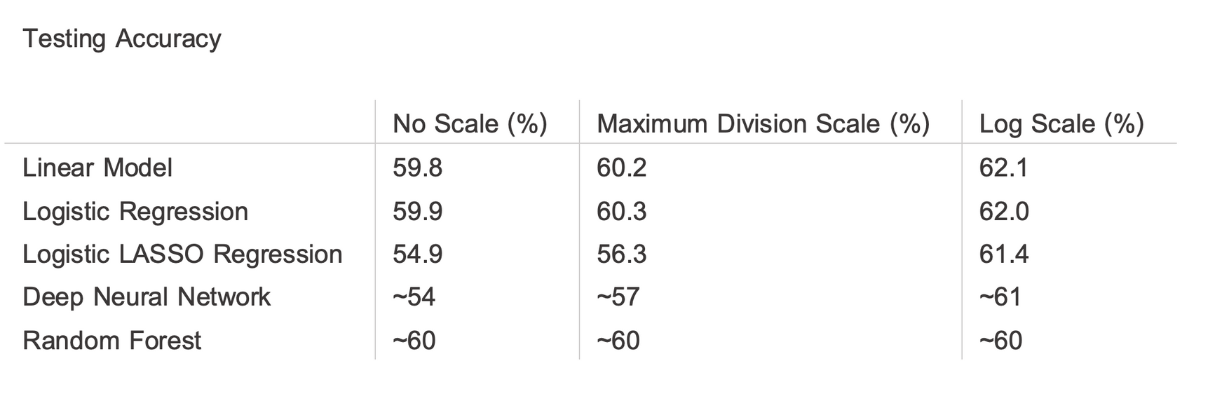
CONCLUSION
Notes:
Overall, the linear model on log scaled data seems to have the highest testing accuracy. But in reality, all of the models present similar accuracies.
More importantly, all of our models show similar importance for select variables like artist popularity, speechiness, valence, and danceability.
However, the low accuracy is an indicator that our variables were not an accurate representation of each song.
Therefore, our study offers some insight into potential factors that make a song a hit song yet also shows that music analysis currently has its limits.

Slide 22
CITATIONS
Cjhutto. “CJHUTTO/Vadersentiment: Vader Sentiment Analysis. Vader (Valence Aware Dictionary and Sentiment Reasoner) Is a Lexicon and Rule-Based Sentiment Analysis Tool That Is Specifically Attuned to Sentiments Expressed in Social Media, and Works Well on Texts from Other Domains.” GitHub, https://github.com/cjhutto/vaderSentiment.
Dave, Dhruvil. “Billboard ‘The Hot 100’ Songs.” Kaggle, 9 Nov. 2021, https://www.kaggle.com/datasets/dhruvildave/billboard-the-hot-100-songs.
Silva, Mariana O. S. “MusicOSet An Enhanced Music Dataset for Music Data Mining.” MusicOSet - an Enhanced Music Dataset for Music Data Mining, https://marianaossilva.github.io/DSW2019/#downloads.
“Web Player: Music for Everyone.” Spotify, https://open.spotify.com/.

